Slide 1

Optimizing websites in a connected world
Damiaan Peeters - #umbUKfest

Slide 2




Damiaan Peeters
Damiaan Peeters' journey showcases a blend of technical expertise, entrepreneurial spirit, and community engagement, making significant contributions to both his local tech community and the broader Umbraco community.
Damiaan Peeters has established a notable presence in the tech and entrepreneurial world, primarily in Belgium. Here are some of his achievements and roles:
Developer, Entrepreneur, and Story Teller at Rood Fluweel: Damiaan has been associated with Rood Fluweel, where he serves as a developer, entrepreneur, and story teller since June 2012​¹​​²​.
Chief Vision Officer at Umbrace and SPOC of Rood Fluweel: He holds the position of Chief Vision Officer at Umbrace, a company specialized in Umbraco and .NET development. He's also the Single Point Of Contact (SPOC) for Rood Fluweel, and is on a mission to inspire people daily​³​.
Umbraco Involvement:
Six-time Umbraco MVP: Recognized as an Umbraco Most Valuable Person (MVP) six times for his contributions to the Umbraco community​⁴​.
Umbraco Documentation Curator: Served as an Umbraco documentation curator, assisting in maintaining and enhancing the documentation of the Umbraco CMS​⁵​.
Umbraco Certified Master: Achieved the status of Umbraco Certified Master, showcasing his expertise in Umbraco technologies​⁶​.
Owner of Umbrace: Damiaan is the owner of Umbrace, a Belgium-based Umbraco-only house, reflecting his expertise and commitment to Umbraco technologies​⁷​.
Public Speaking and Community Engagement:
Speaker at Umbraco Developer Conference 2018: Shared insights on integrating external data magically at the Umbraco developer conference in 2018​⁷​.
Long-time Umbraco Supporter: Has been a long-time supporter of Umbraco, contributing to its community and events over the years​⁵​.
Miscellaneous:
Various Developer Roles: Holds badges for roles such as Developer Advocate, Backend Developer, Software Developer, and expertise in CSharp and Umbraco technologies​⁶​.
Interest in SEO and Magic: Besides his technical pursuits, Damiaan has interests in Search Engine Optimization (SEO) and magic, which he practices in his spare time​⁷​.
(according to chatgpt4 browse function)

Slide 3
Disclaimers
45 minutes is not long to dive deep
The longer it goes, the more technical we go
This presentation will contain code
Images are from DALL·E, except if mentioned otherwise
I speak French with my colleagues. English is getting rusty so bear with me ☺
This presentation contains no magic
Notes:
45 minutes is not too long
And we will have some code
It feels like having to heavy sessions, so no magic in this presentation

Slide 4

Some background
Notes:
Story
I went to Madagascar for meeting and training colleagues. It was a quite short, but interesting adventure.
First let me show you a few pictures I took to give you an idea of what I saw.

Slide 5
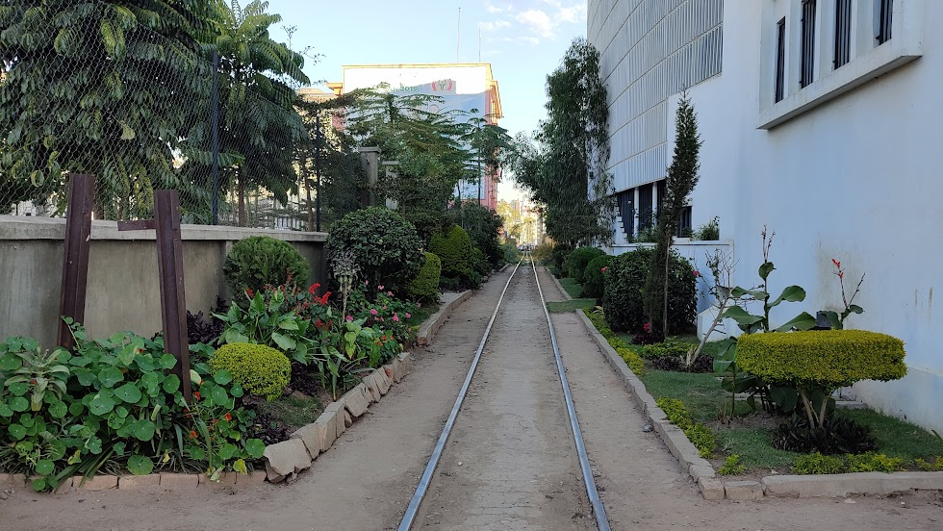
Notes:
The (broken) train track leading to the unused central train station in Tana (Antananarivo).
Madagascar is known for its beautiful nature.
Unfortunately, I did not have much time to see the rest of the country.
Madagascar is also known as a developing country.

Slide 6
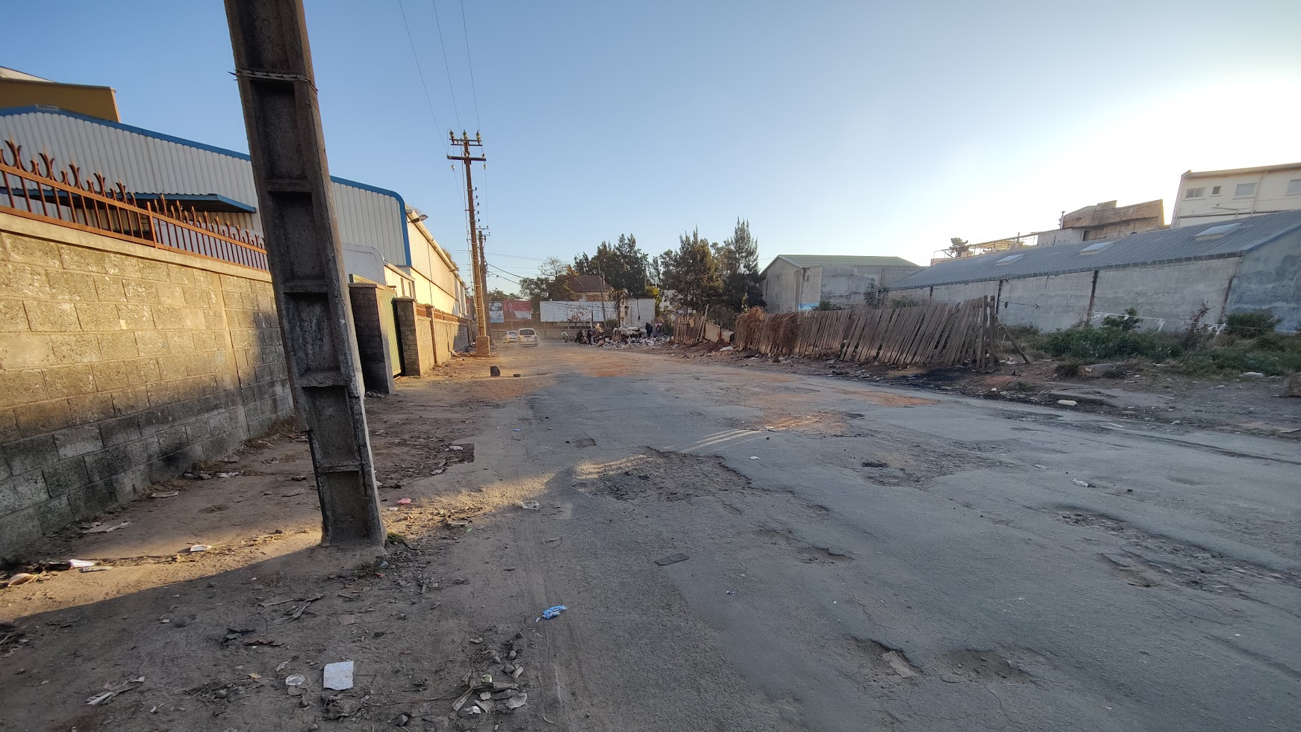
Notes:
It faces various economic, social and political challenges.
This is a photo I took on a walk I did without a guide.
To support my photo’s,

Slide 7

Notes:
… I did find some interesting numbers on this website.
I did add the Uk numbers just below on every slide.

Slide 8
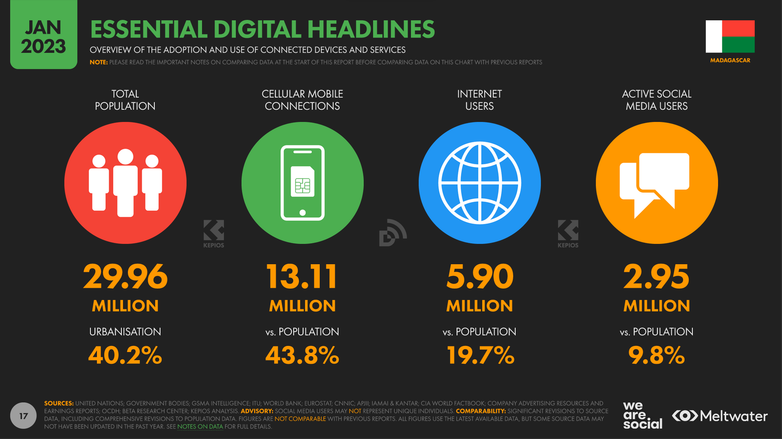
UK
84.5%
129.6%
97.8%
84.4%
Notes:
Can you image a country of 30 million inhabitants
But only 20% of them are internet users

Slide 9
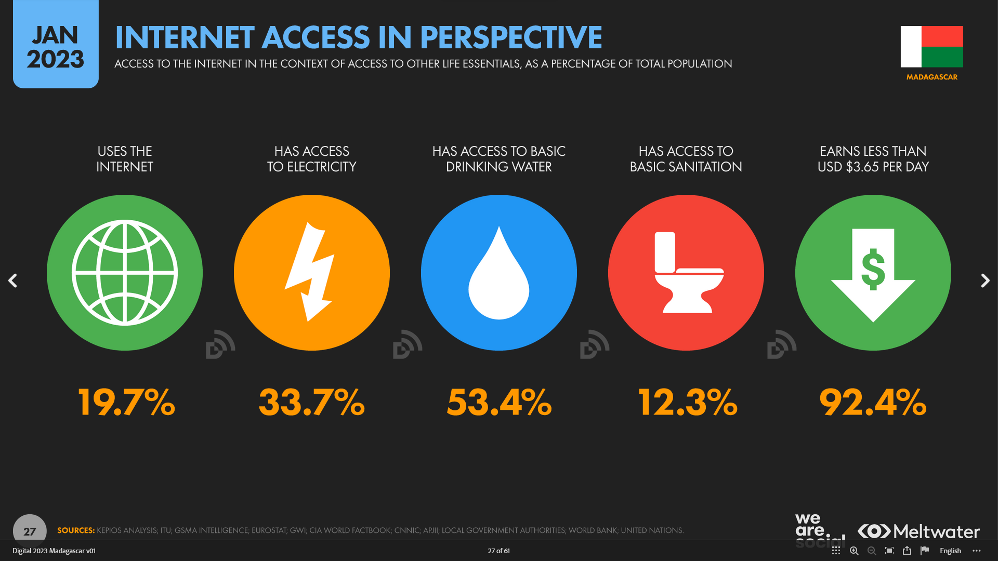
UK
97.8%
100%
100%
99.1%
0.5%
Notes:
One number that I didn't want to withhold from you is this :
there are more people who have access to the internet than to basic sanitation (Red Circle)

Slide 10
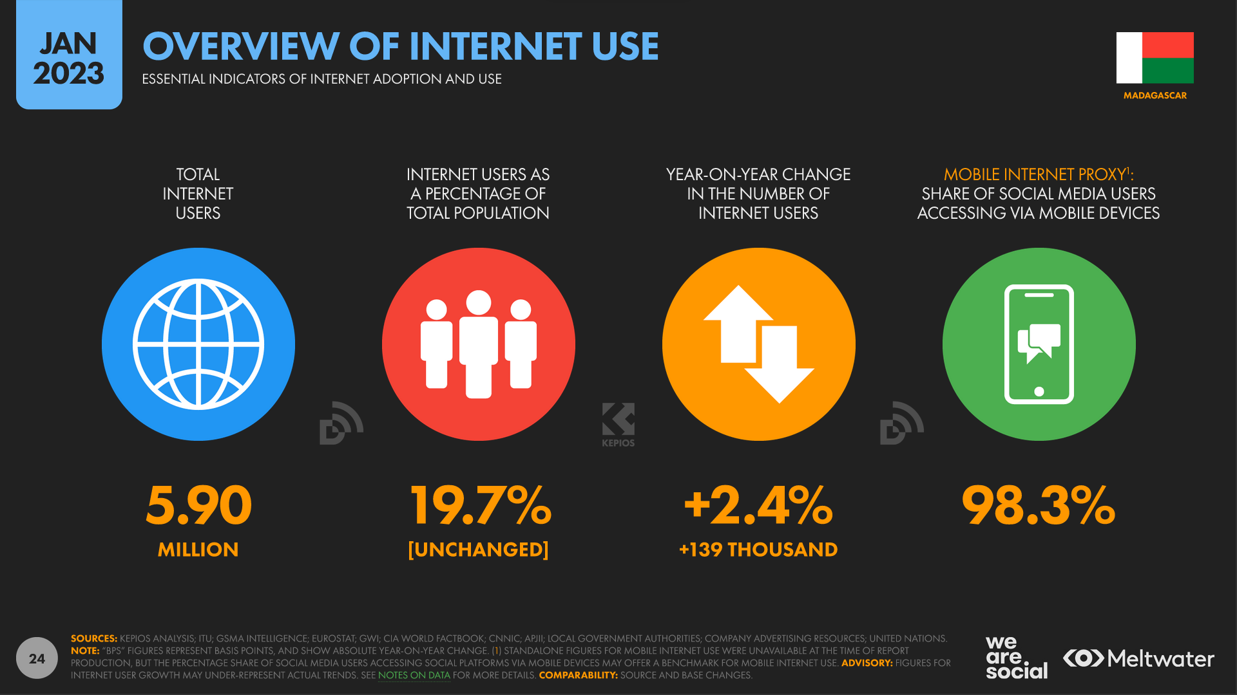


Notes:
If they are using SOCIAL MEDIA, it’s done most of the time on a smartphone.
And that makes sense, because …

Slide 11
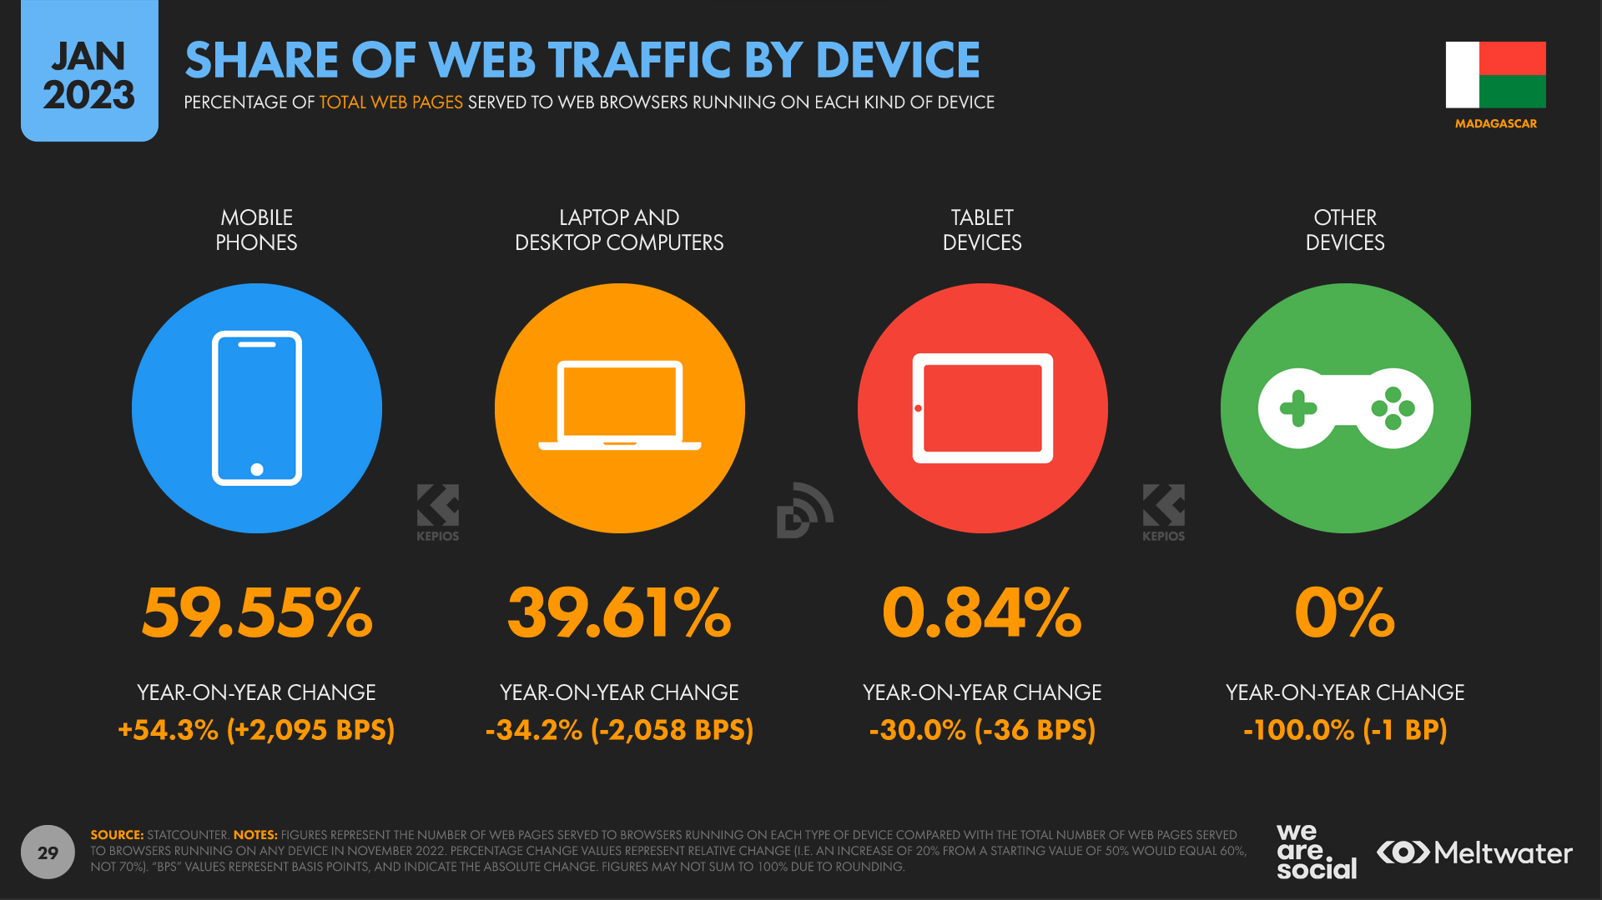
UK
47.78%
47.43%
4.70%
0.09%
Notes:
… There are more mobile phones using traffic than there are laptop/ desktops
Compare that against the UK number.

Slide 12
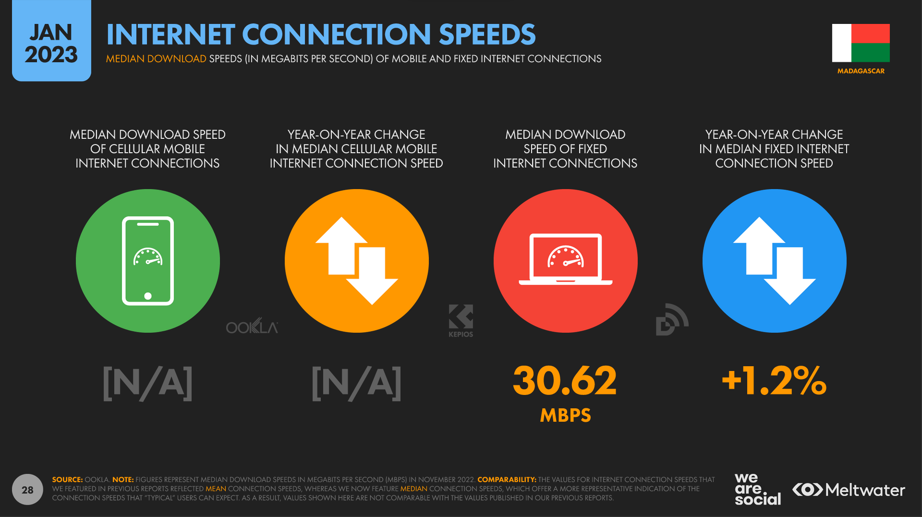
UK
46.02 mbps
73.21 mbps
24.5%
Notes:
… these number.
Fixed lines are faster in the UK than the average mobile connections in Mada.
Let discuss another issue, using a photo I took.

Slide 13
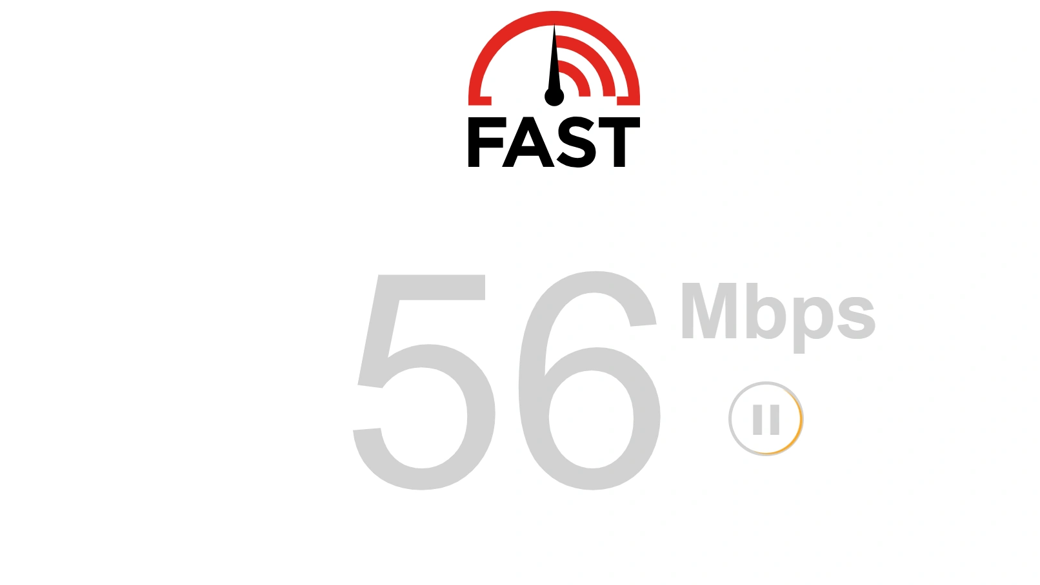

Slide 14

Power interruptions
(Photo by me)
Notes:
And this is one the worst photo’s but one of the most awesome views I had over Tana.
I am still very grateful to Anna, one of my collegues that she took me there.
But do you see the issue?
At the buildings that are closest, there are no lights on. There was a power outage
It wasn't by chance; it happens regularly. Sometimes neighbourhoods in the capital are turned off because they don't have enough electricity.
Imagine, having no electricity several times a week.
The SAD thing is, not only madagascar is the issue.

Slide 15

Not only madagascar
Your neighbours
Mobile users
Users on public networks
(elderly with) outdated devices
Users with limited hardware
Low-income individuals
Rural residents
Users with disabilities
Notes:
To what most people believe, NOT ONLY developing countries.
People with limited hardware. People in rural areas
Individuals who might have issues with very large websites and limited internet include:
Rural Residents: People living in rural or remote areas often have limited internet access or rely on satellite internet, which can have data caps and slower speeds.
Developing Countries: In many developing nations, internet infrastructure may not be as robust, leading to slower internet speeds. Large websites can be difficult to load or may consume a significant portion of a user's data plan.
Older Adults: Some older adults might be using outdated devices or may not have updated their software, making it challenging to load modern, large websites.
Low-Income Individuals: People with limited financial resources might not be able to afford high-speed internet or may rely on pay-as-you-go mobile data. Large websites can quickly consume their available data.
Users on Public Networks: Those using public Wi-Fi, such as in libraries or cafes, might experience slower speeds, especially during peak usage times. Large websites can be particularly taxing on such networks.
Mobile Users: Even in areas with good internet connectivity, mobile users might face challenges with large websites. These sites can be data-intensive and might not be optimized for mobile viewing.
Users with Limited Hardware: People using older computers, tablets, or smartphones might experience slower load times or even crashes when accessing large websites.
Users with Disabilities: Large websites that aren't designed with accessibility in mind can be challenging for people with disabilities, especially if they rely on screen readers or other assistive technologies.

Slide 16
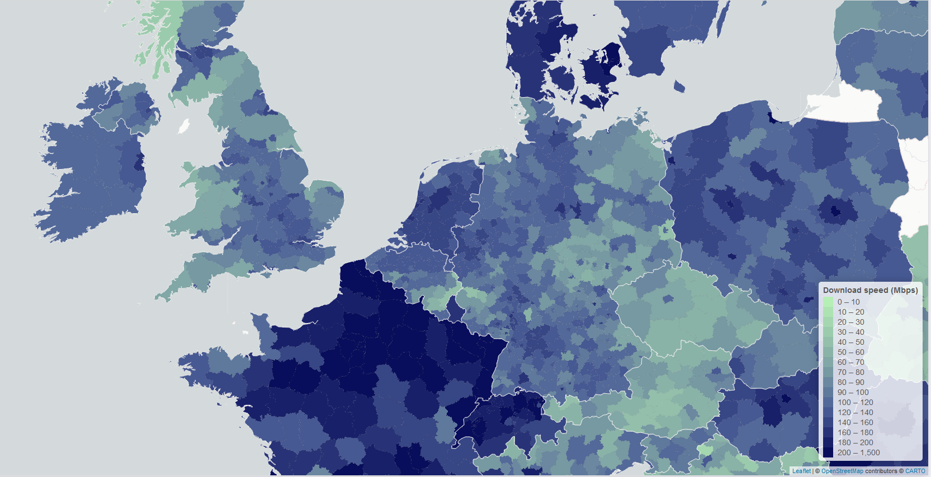
https://datavis.europeandatajournalism.eu/obct/connectivity/
Notes:
This is a NUTS-3 map from Q1 2022 with the measured connection speeds

Slide 17

Understanding the issue
Notes:
While they have a fast internet connection, the uplink to the rest of the internet is pretty slow.
To show this, I asked my colleague Anna to do a trace route to facebook.
And it turns out to be slow. But not too bad.
PROMPT: Illustration on a black background for a PowerPoint slide of a brain intertwined with Madagascar's unique flora and fauna, showcasing the connection and depth of understanding.

Slide 18
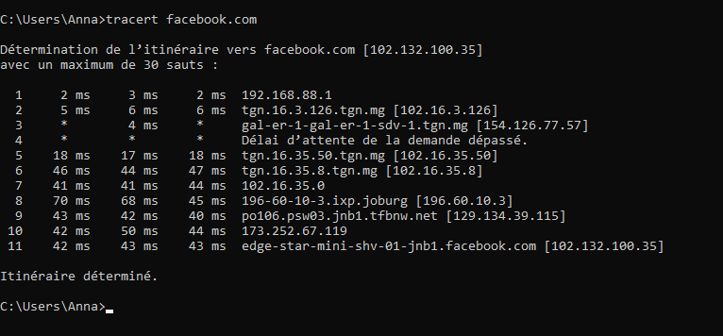
Tracert to facebook
Notes:
Tracert to facebook from Mada.
Only a small bump of ms in Mada.
And it passas JOBURG

Slide 19
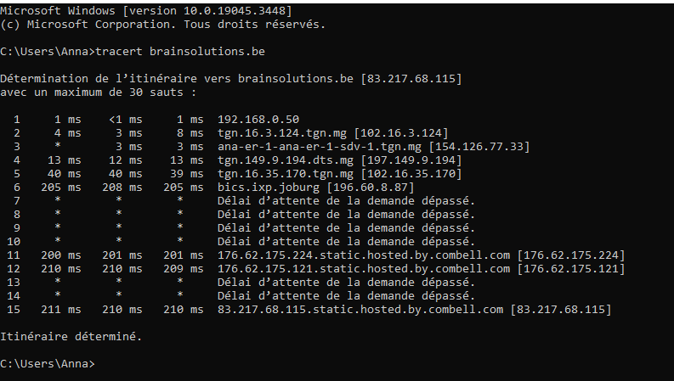
Tracert to a server in Belgium
Notes:
This is a trace route from MG to a website hosted in Belgium.
Look at this delay in JOBURG

Slide 20

BGP routing
Notes:
The reason why this might happen is due to the Border Gateway Protocol
3 reasons why this might happen
* Local internet setup
* AS uplink
* Money
PROMPT: DALL·E 2023-10-24 21.08.33 - Render of a 3D world globe with Madagascar, Johannesburg, and Belgium emphasized. Luminous arcs trace the route of internet traffic, creating a visual

Slide 21

Notes:
The issue is not only routing. We are using too much energy as I personally experienced in Mada during all the power outages.
If we can improve our websites and use less resources it would be benefit a lot of people.

Slide 22

Building fast umbraco website
So that everyone can enjoy your creations
Notes:
And when you start thinking about it, you get really depressed.
If you start imagining people (far away and close) can’t enjoy the same experience.
Therefor promised myself BEFORE I LAUNCH a new beast, to verfify if I can …

Slide 23

Notes:
Minimize
1) the amount of data and
2) the # of connections
when developing websites or applications
Because with a few best practices we can already improve a lot.
Prompt: Illustration of a sleek dashboard with two gauges labeled 'data' and 'connections'. The needles on the gauges are moving towards the 'low' end. Large, bold arrows point downwards, reinforcing the message of reduction. The background is filled with fading data streams and connection lines.

Slide 24

For Umbraco Development
Work locally
Use serialized content (umbraco cloud, usync + zip)
Syncronise MEDIA on local network
Notes:
Before we dive into frontend optimizations, I learned these 3 things when working with offshore teams.
Work locally
Use serialized content (umbraco cloud, usync + zip)
Syncronise MEDIA on local NETWORK

Slide 25

Front-end optimizations

Slide 26


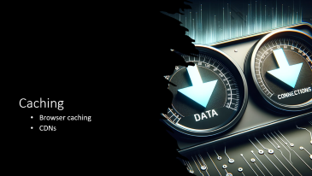
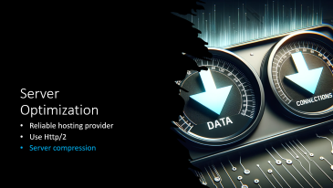
Front-end overview

Slide 27
Limit the Number of Connections

Slide 28
Limit the number of connections
Http/2
Bundle CSS & JS
Limit the number of redirects

Slide 29
Content Optimization
Compress images & use efficient formats
Css, Js & Html

Slide 30

Images
Correct size
Efficient compression
Lazy load

Slide 31
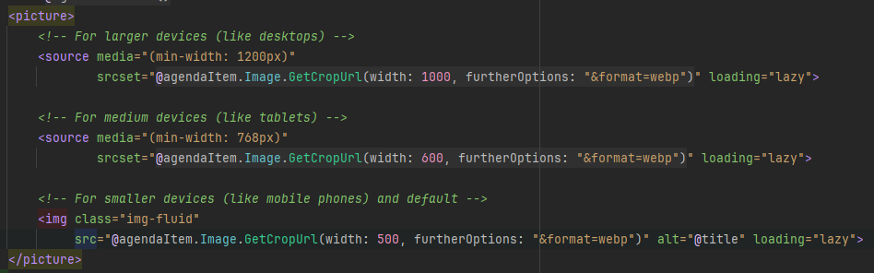
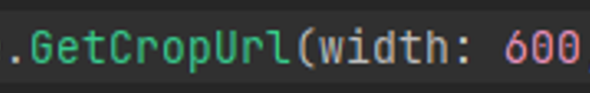
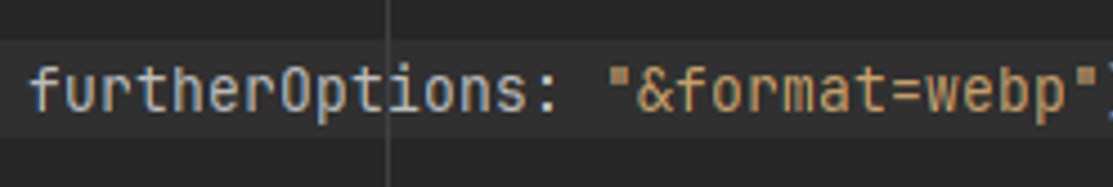
Responsive image
Notes:
Responsive
Correct Size
Format
Lazy load

Slide 32
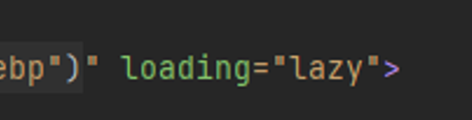
Lazy load images
https://developer.mozilla.org/en-US/docs/Web/Performance/Lazy_loading
Notes:
Lazy loading is a strategy to identify resources as non-blocking (non-critical) and load these only when needed.
It's a way to shorten the length of the critical rendering path, which translates into reduced page load times.
No javascript needed. This is standard html

Slide 33
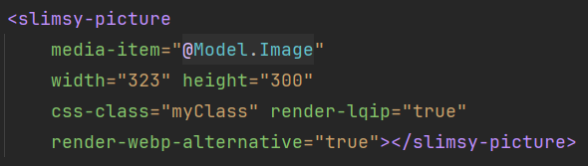
Using Slimsy
https://marketplace.umbraco.com/package/our.umbraco.slimsy
Notes:
If you don’t like doing this manually, use eg Slimsy. A package which does it all for you.
LQIP = low quality Image Placeholders

Slide 34
Media to blob storage
Advantages
Other BGP routing
Cookieless
E-tag
https://docs.umbraco.com/umbraco-cms/extending/filesystemproviders/azure-blob-storage/
Notes:
As we have seen, other providers might have better connections.
Not sending cookies for static assets saves bandwidth
E-tag ➔ later

Slide 35

Js & Css
Notes:
I guess everyone knows this. But let us review a few things to fresh things up.

Slide 36
Optimize Js & css
Minimize connections
Send less data
Minify CSS and JS Files (*)
Avoid Inline JS and CSS
Use Content Delivery Networks (CDN)
Remove Unused CSS and JS (*)
Avoid Inline JS and CSS
Combine Multiple Files
Implement HTTP/2
Browser Caching (*)
Notes:
Multiple ways to improve JS & CSS.
Blue marked we will discuss as they can be easily implemented without much effort.

Slide 37
Use less CPU & power
Prioritize Critical CSS
Defer Non-Critical JS (*)
Use Asynchronous Loading for JS
Optimize CSS Selectors
Optimize Animations
Use Efficient Libraries and Frameworks
Notes:
Optimizing can also save on power usage. So, let’s dive in.

Slide 38
Minify & bundle CSS and JS Files
SmidgeHelper.RequiresCss( "~/Assets/site.css", "~/Assets/theme.css");
In your master.cshtml
<environment names="Development"> @await SmidgeHelper.CssHereAsync(debug: true) @await SmidgeHelper.JsHereAsync(debug: true) </environment> <environment exclude="Development"> @await SmidgeHelper.CssHereAsync(debug: false) @await SmidgeHelper.JsHereAsync(debug: false) </environment>
Notes:
If you don’t have a complete front-end build system, use Smidge it is bundled with umbraco by default to minify and bundle css & js files.
It can be archived in multiple ways, this is only one where one of my colleagues used a default asp.net feature to show unbundled files in development env. While I am pretty sure that this can also be switch with the CMS: Global:hosting:Debug in the appsettings.json file
Using smidge has other advantages which we will discuss later.

Slide 39
Partial view
SmidgeHelper .RequiresCss("~/Assets/Views/ImageBlock.css") .RequiresJs("~/Assets/Views/ImageBlock.js");
Render automatically on the master
Notes:
In addition to the previous slide, do not send all JS & CSS always.
You can define just the parts which need to be send over the line for that particular page.

Slide 40
Defer Css
SmidgeHelper.CreateCssBundle("css-master") .RequiresCss("~/css/theme.css“, "~/css/custom.css"); SmidgeHelper.CreateCssBundle("css-defer") .RequiresCss("~/css/defer.css");
<link href="css-master" rel="stylesheet" /> <link href="css-defer" rel="stylesheet" defer />
Notes:
If you can, you should shorten the critical loading path
This can be done by creating different bundles

Slide 41
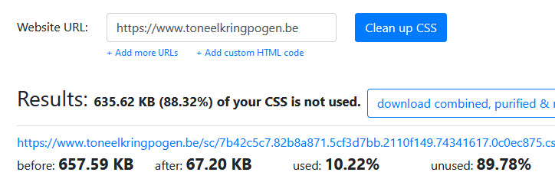
Remove unused CSS
https://purifycss.online/
Notes:
This is not really umbraco related?
But if they say “remove unused css”, this is one example.
I have friends how bought a theme and I helped them setting up the website.
Look how much
1. Data is send over the line which will never be used
2. How much lost CPU cycles on every browser rendering this page

Slide 42
Server Optimization
Reliable hosting provider
Use Http/2
Server compression
Notes:
Not only JS / CSS
You can also tweak loads of server settings

Slide 43
Response compression
https://developer.mozilla.org/en-US/docs/Web/HTTP/Compression
Notes:
To diminish data being send
* Minimize bandth utilization

Slide 44
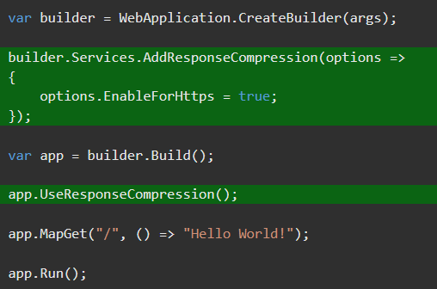
Response Compression on the server
https://learn.microsoft.com/en-us/aspnet/core/performance/response-compression
Notes:
Use Anti forgery tokens to prevent BREACH & CRIME attacks
The performance of the response compression middleware probably won't match that of the server modules
Use Response Compression Middleware when the app is:
Unable to use the following server-based compression technologies:
IIS Dynamic Compression module
Apache mod_deflate module
Nginx Compression and Decompression
Hosting directly on:
HTTP.sys server
Kestrel server

Slide 45
Caching
Browser caching
CDNs

Slide 46

Browser caching
Notes:
BROWSER CACHING
Bandwidth Saving: By avoiding the retransmission of unchanged resources.
Efficient Caching: Allows clients to validate their cached resources and ensure they are up-to-date.

Slide 47
Browser caching
Static content (via iis module)
Css & js (smidge)
Image (imagesharp.web & blob storage)
To do:
Rendered Umbraco page
Notes:
For static assets a lot is done by Umbraco If debug-mode is disabled.
But if you have assets not (Smidge, imagesharp & blob storage served), then…

Slide 48
Cache static Content
<configuration> <system.webServer> <staticContent> <!-- Set expire headers to 30 days for static content--> <clientCache cacheControlMode="UseMaxAge“ cacheControlMaxAge="30.00:00:00" /> </staticContent> </system.webServer> </configuration>
In IIS (➡️) or kestrel (⬇️)
app.UseStaticFiles(new StaticFileOptions { HttpsCompression = Microsoft.AspNetCore.Http.Features.HttpsCompressionMode.Compress, OnPrepareResponse = ctx => { // Cache static files for 30 days ctx.Context.Response.Headers.Append("Cache-Control", "public,max-age=2592000"); ctx.Context.Response.Headers.Append("Expires", DateTime.UtcNow.AddDays(30).ToString("R", CultureInfo.InvariantCulture)); } });
Notes:
… then you’ll need to add some extra settings in IIS on in your Asp.net pipeline.

Slide 49
ETag & if-none-match headers
https://developer.mozilla.org/en-US/docs/Web/HTTP/Headers/ETag
Notes:
The ETag (or entity tag) HTTP response header is an identifier for a specific version of a resource.
It lets caches be more efficient and save bandwidth, as a web server does not need to resend a full response if the content was not changed.
The If-None-Match HTTP request header makes the request conditional.
For GET and HEAD methods, the server will return the requested resource, with a 200 status, only if it doesn't have an ETag matching the given ones.
For other methods, the request will be processed only if the eventually existing resource's ETag doesn't match any of the values listed.
https://developer.mozilla.org/en-US/docs/Web/HTTP/Headers/ETag

Slide 50
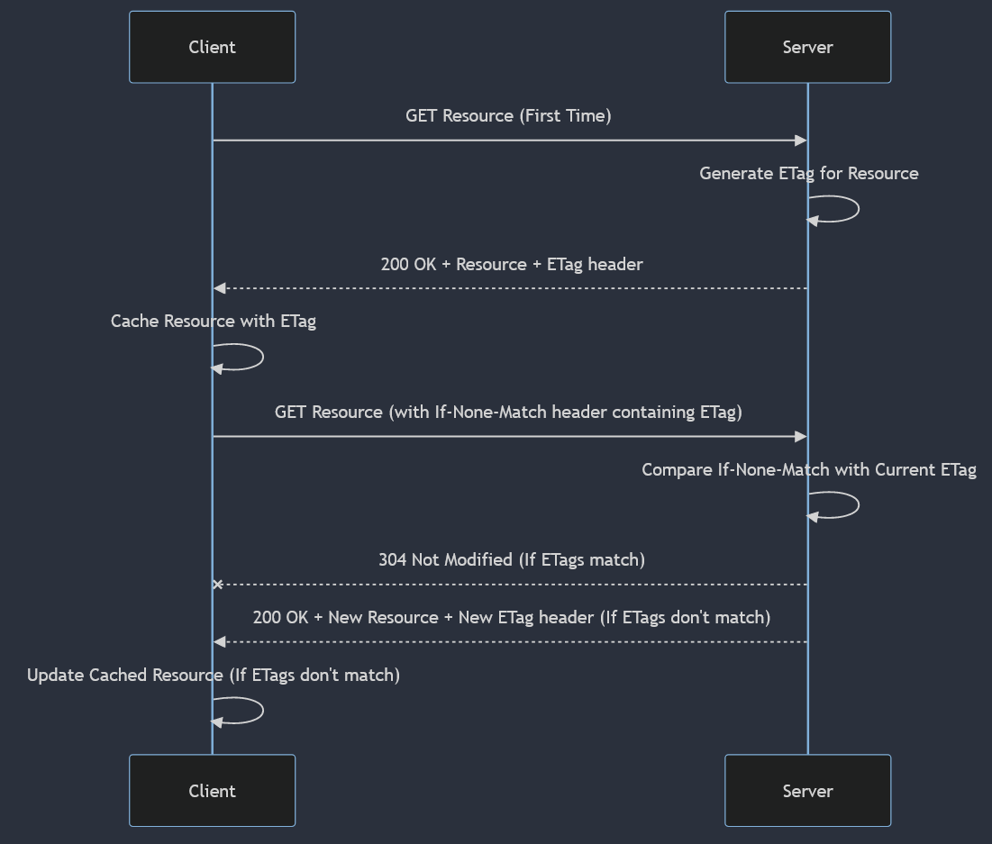
ETag flow
Notes:
sequenceDiagram
participant Client
participant Server
Client->>Server: GET Resource (First Time)
Server->>Server: Generate ETag for Resource
Server-->>Client: 200 OK + Resource + ETag header
Client->>Client: Cache Resource with ETag
Client->>Server: GET Resource (with If-None-Match header containing ETag)
Server->>Server: Compare If-None-Match with Current ETag
Server--xClient: 304 Not Modified (If ETags match)
Server-->>Client: 200 OK + New Resource + New ETag header (If ETags don't match)
Client->>Client: Update Cached Resource (If ETags don't match)

Slide 51
public class ETagMiddleware { public ETagMiddleware( RequestDelegate next, IRuntimeState runtimeState) { … } public async Task InvokeAsync(HttpContext context) { // umbraco must be running if (_runtimeState.Level < RuntimeLevel.Run) { await _next(context); return; } // Get the body content from the response stream var originalResponseBodyStream = context.Response.Body; using var responseBody = new System.IO.MemoryStream(); context.Response.Body = responseBody; // Call the next middleware in the pipeline await _next(context); var responseBodyBytes = responseBody.ToArray(); // Compute ETag for the response content using SHA-1 var etag = ComputeETag(responseBodyBytes); context.Response.Headers.Add(HeaderNames.ETag, etag); // Check the incoming If-None-Match header if (context.Request.Headers
.TryGetValue(HeaderNames.IfNoneMatch,
out var incomingEtag) && incomingEtag == etag) { context.Response.StatusCode =
StatusCodes.Status304NotModified; return; } // Write the original response body to the original response stream await originalResponseBodyStream
.WriteAsync(responseBodyBytes, 0, responseBodyBytes.Length); } private string ComputeETag(byte[] content) { return … // some computed hash
} }
Notes:
/ EXPLAIN STEPS /
To wire this middleware up …

Slide 52
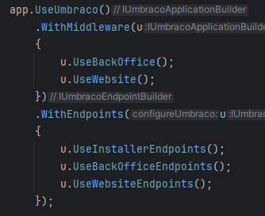
Register your middleware
public class EtagMiddlewareStartupFilter : IUmbracoPipelineFilter { public string Name => "Etag"; public void OnEndpoints(IApplicationBuilder app) { } public void OnPostPipeline(IApplicationBuilder app) { app.UseMiddleware<ETagMiddleware>(); } public void OnPrePipeline(IApplicationBuilder app) { } }
public class ConfigureEtagPipelineOptions : IConfigureOptions<UmbracoPipelineOptions> { public void Configure(UmbracoPipelineOptions options) { options.AddFilter(new EtagMiddlewareStartupFilter()); } }
// Set debug = false to test ETag middleware services.ConfigureOptions<ConfigureEtagPipelineOptions>();
Notes:
Interfere with the .UseMiddleware.
You can do so with an IUmbracoPipelineFilter. The pipeline filter allows you to add extra middelware in between the Umbraco core middleware.

Slide 53
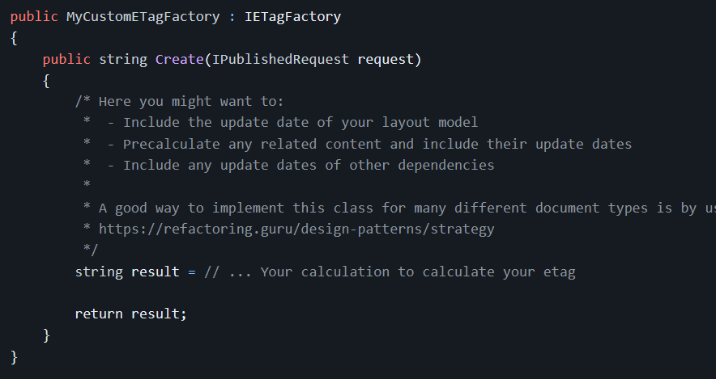
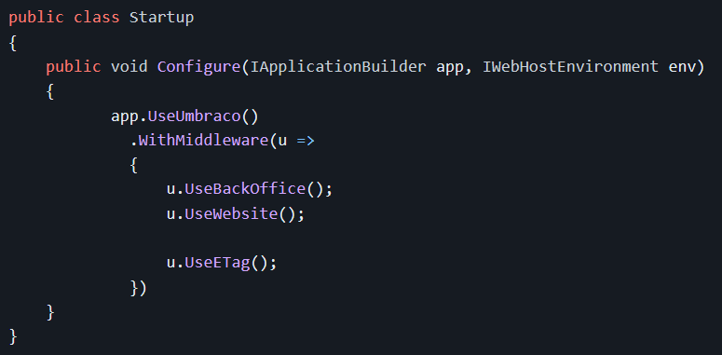
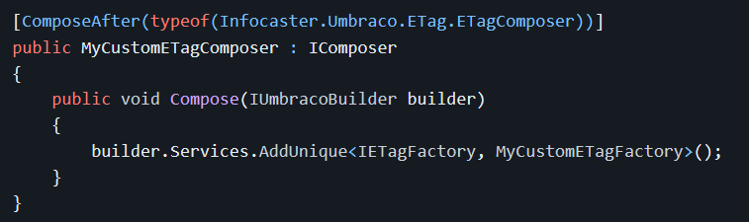
Easy Etag Solution?
dotnet add package Infocaster.Umbraco.ETag

Slide 54
Front-end improvements
Limit the number of connections
Content Optimization
Compress images & use efficient formats
Css, Js & Html
Optimize webfonts
Lazy loading
Prioritize Above-the-Fold
Server Optimization
Reliable hosting provider
Use Http/2
Server compression
Caching
Browser caching
CDNs

Slide 55

CDN

Slide 56
CDN
Caching Content
Geographical Distribution:
Request Routing
Content Delivery
Optimization and Compression
Load Balancing
Security and DDoS Protection
Reduced Latency and Faster Load Times
Scalability
Notes:
Caching Content: When a website decides to use a CDN, static content like images, stylesheets (CSS), JavaScript files, and sometimes even entire web pages, are copied and stored (cached) across multiple servers in the CDN network.
Geographical Distribution: The servers in a CDN are strategically located across different regions and countries to ensure proximity to end-users. These servers are known as edge servers or CDN nodes.
Request Routing: When a user makes a request to access content, the CDN redirects the request to the nearest edge server based on factors such as proximity, server health, and load.
Content Delivery: The edge server then delivers the requested content to the user. If the content is not available or outdated on the edge server, it fetches the latest content from the origin server (the original server where the website is hosted) or another nearby edge server and then delivers it to the user.
Optimization and Compression: CDNs can also optimize and compress files for faster delivery. They might minify CSS, JavaScript, or optimize images to reduce loading times.
Load Balancing: CDNs can distribute the network traffic across multiple servers, which helps in balancing the load, ensuring no single server is overwhelmed with too much traffic.
Security and DDoS Protection: CDNs can provide additional security by mitigating Distributed Denial of Service (DDoS) attacks and ensuring that malicious traffic is handled before it reaches the origin server.
Reduced Latency and Faster Load Times: By serving content from the nearest edge server, CDNs reduce the physical distance the data has to travel, leading to faster load times and reduced latency.
Scalability: CDNs make it easier for websites to handle spikes in traffic, as the distribution of requests can scale up or down as needed.
Cost and Bandwidth Savings: By offloading traffic and requests from the origin server to the CDN, there can be significant savings in bandwidth costs.

Slide 57

Notes:
As we draw to a close, I extend my heartfelt gratitude for your unwavering attention.
It is my sincere hope that you leave today ignited with
a passion to craft websites that are swift,
universally accessible,
and contribute to a sustainable world.
Let us envision and build a digital realm where every creation is a testament to inclusivity and innovation, ensuring that the wonders of your creativity are experienced and cherished by all.
Thank you

Slide 58
Resources
All code, DALL·E prompts, and slide deck on github
https://github.com/dampee/optimizing-websites-in-a-connected-world
Connect with me
https://hachyderm.io/@dampee
https://twitter.com/dampeebe
https://www.linkedin.com/in/dampee/
damiaan.peeters@brainsolutions.be

